Slide 1
Object Oriented Programming
Lecture 02

Slide 2
Java Terminology
Java Virtual Machine(JVM) –set of computer software programs and data structures that use a virtual machine model for the execution of other computer programs and scripts.
Java Runtime Environment(JRE) –A runtime environment which implements Java Virtual Machine, and provides all class libraries and other facilities necessary to execute Java programs. This is the software on your computer that actually runs Java programs.

Slide 3
Java Terminology (cont.)
Java Development Kit(JDK) –The basic tools necessary to compile, document, and package Java programs (javac, javadoc, and jar, respectively). The JDK includes a complete JRE.
Application Programming Interface (API) –Contains predefined classes and interfaces for developing Java programs.

Slide 4
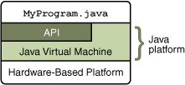
The Java Platform
The Java platform has two components:
◦The Java Virtual Machine
◦The Java Application Programming Interface (API)

Slide 5
JAVA Editions
Java SE(short for Standard Edition) –runs on desktops and laptops
Java ME(short for Micro Edition) –runs on mobile devices such as cell phones
Java EE(short for Enterprise Edition) –runs on servers

Slide 6
A Closer Look at the First Sample Program
keyword class to declare that a new class is being defined.
FirstPro is an identifier that is the name of the class.
The main( ) method is simply an entry point for an application.
(Ref: Lecture Note 01 – First java Program)

Slide 7
Progress Check
Where does a Java program begin execution?
What does System.out.println( ) do?
What is the name of the Java compiler?

Slide 8
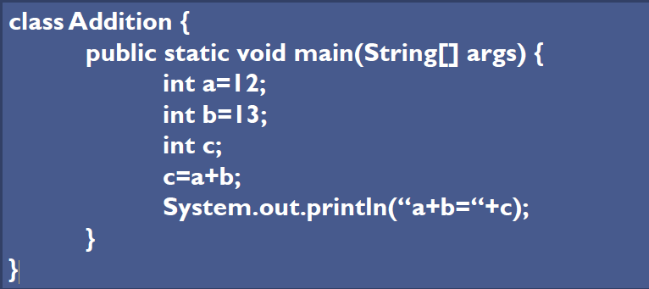
Statements, Expressions & Variables
Write a simple Java program which adds 12 and 13, and displays the result on the screen

Slide 9
Statements
Statements
are used to accomplish simplest tasks in Java
forms simplest Java operations.
can be single line or Span to multiple lines.
does not necessarily return a value.

Slide 10

Expressions
simplest form of Statements.
returns a value when evaluated.
can be assigned to a variable or can be tested in Java statements.
most expressions are a combination of Operators & Operands

Slide 11

Variables (Ref. Lec 01)
Variables are locations in memory in which values can be stored.
Each Variable has a Type, Name and a Value
After Declaring, it can be used to store values of the appropriate Type

Slide 12
Reference Data Type
Reference types (composite)
objects
Arrays
strings are supported by a built-in class named String (java.lang.String)

Slide 13

Variable Naming
Use meaningful Names such as number, areaOfCircle, firstName
Convention is to start a variable with a lower case
If the name is made up of several words, then from the second word onwards the first letter of the word is capital.

Slide 14
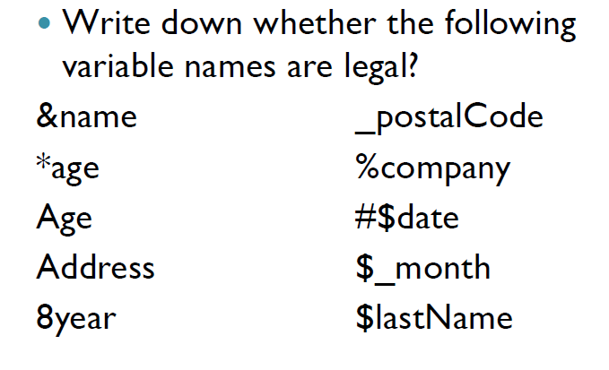

Slide 15
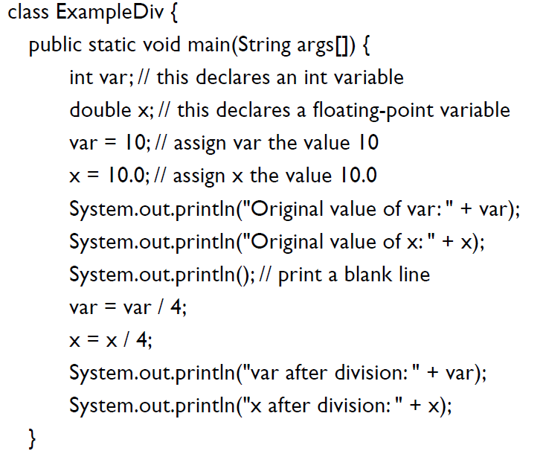

Slide 16
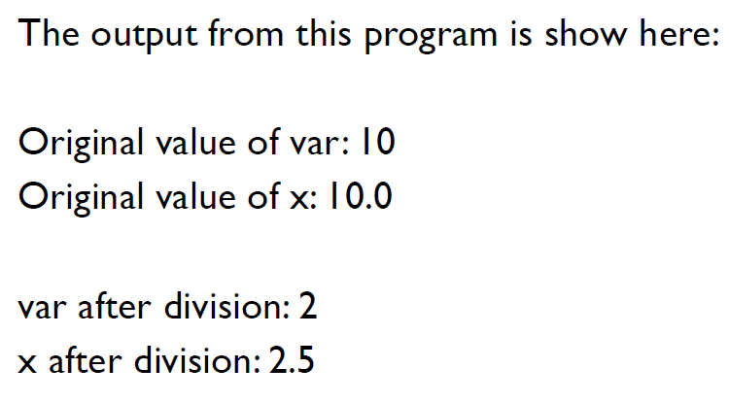

Slide 17
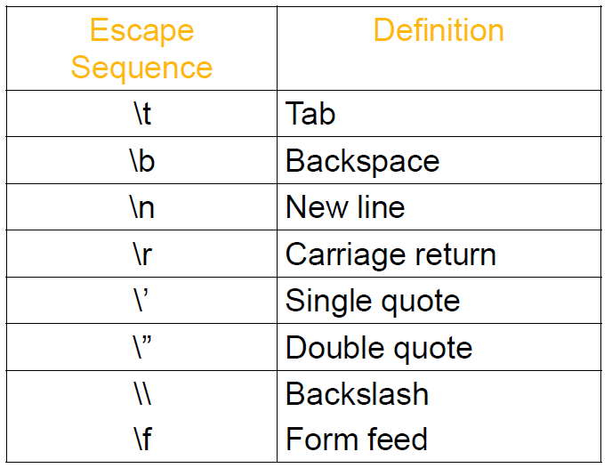
Escape Sequence Characters

Slide 18
Exercise:
Write a simple Java program which divides 12 by 5 and displays the result on the screen.
Write a simple Java program multiplies 12.4 and 45678932.You should display the result on the screen up to two decimal points
Write a program which converts inches to centimeters (1m= 39 inches)

